Slide 1

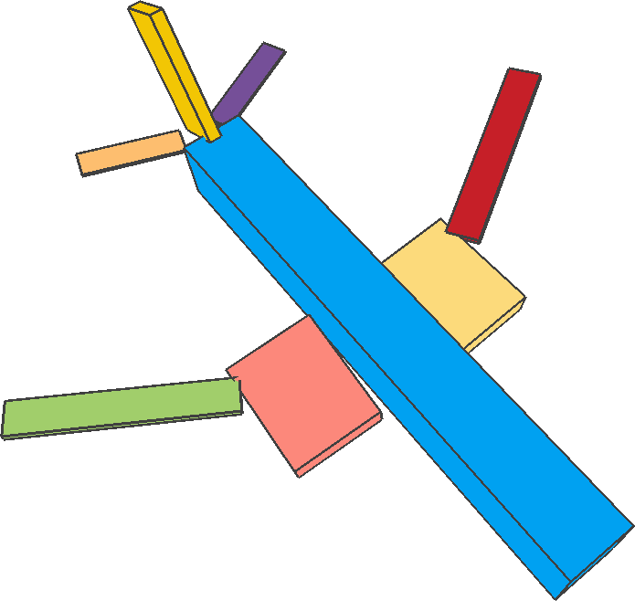
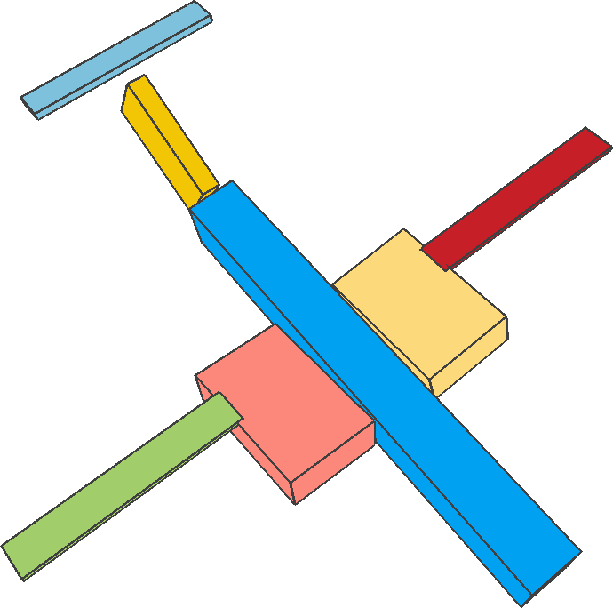
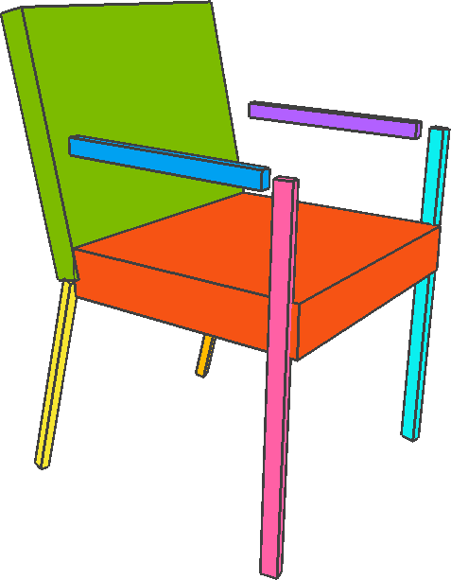
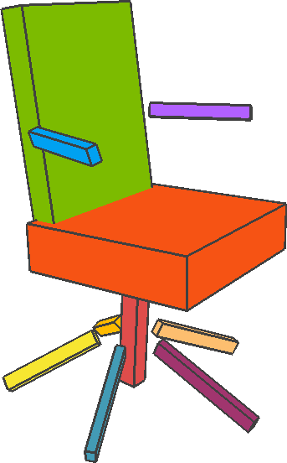



Learning Adaptive Hierarchical Cuboid Abstractions of 3D Shape Collections
Chun-Yu Sun, Qian-Fang Zou, Xin Tong, Yang Liu
Notes:
Thanks for the introduction.
I’m Chun-Yu from Tsinghua University.
Today I am going to introduce our paper of learning adaptive hierarchical cuboid abstractions of 3D shapes.

Slide 2
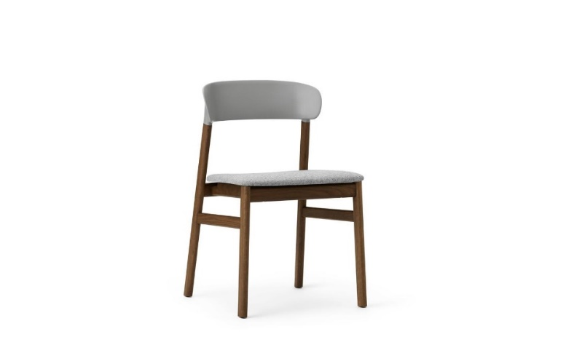
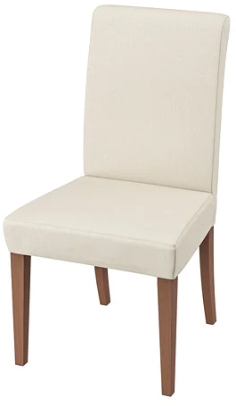
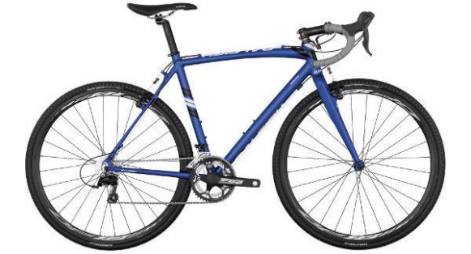
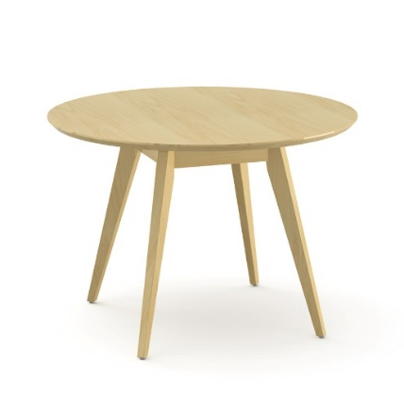
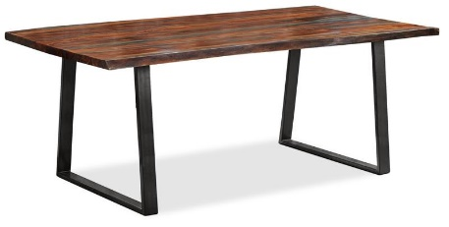
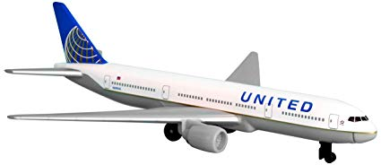
3D Shape Structure
Notes:
In the real world, man-made objects often exhibit strong structures.
Analysis of 3D shape structure is an important task in 3D shape understanding.
Although 3D data is increasing, there is relatively little data that has structural annotation.
Unsupervised learning can help people get structural information.

Slide 3
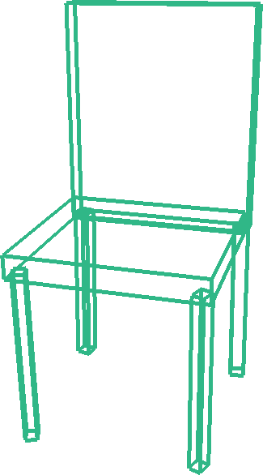
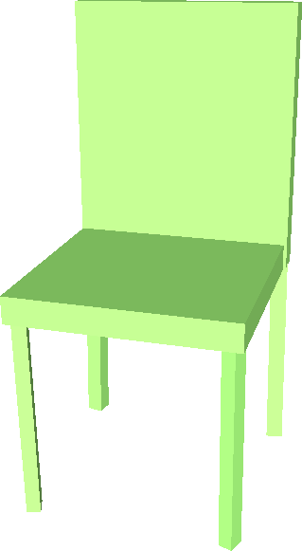
3D Cuboid Abstraction
Notes:
We can abstract a 3D shape as an assembly of primitives, to get the underlying shape structure.
The cuboid is a relatively simple primitive (click) which can represent the part of 3D shapes.
The shape abstraction can help us, to exploit the intrinsic structure coherence, predict object functionality, edit 3d shapes, and generate novel shapes.

Slide 4
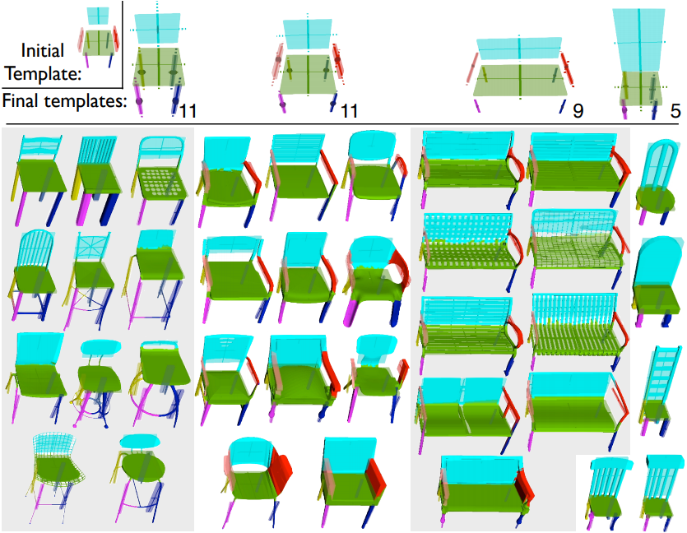
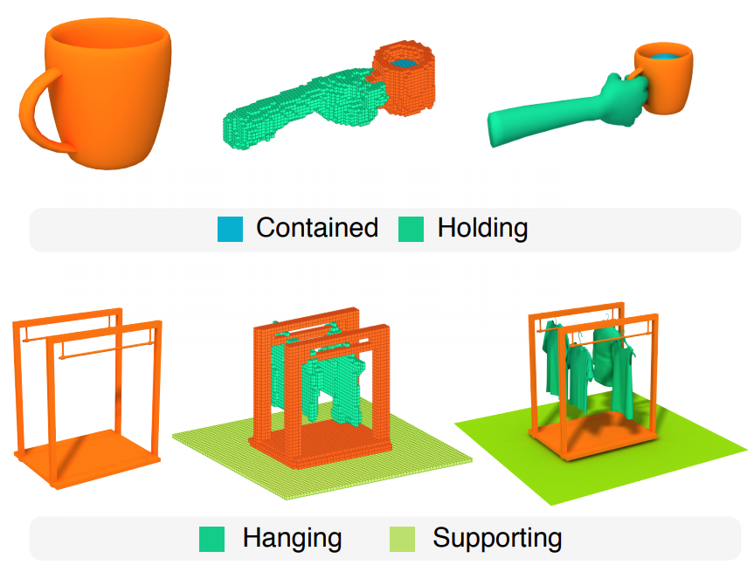
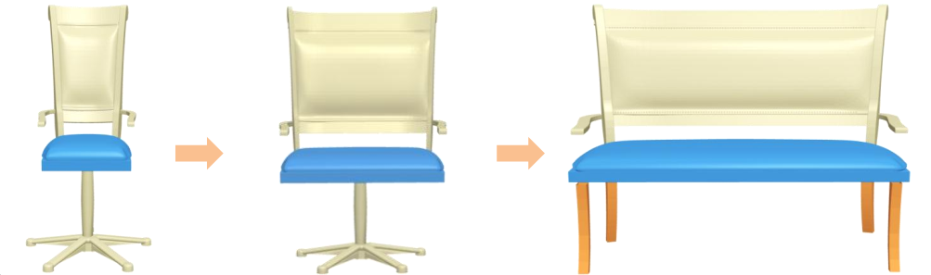
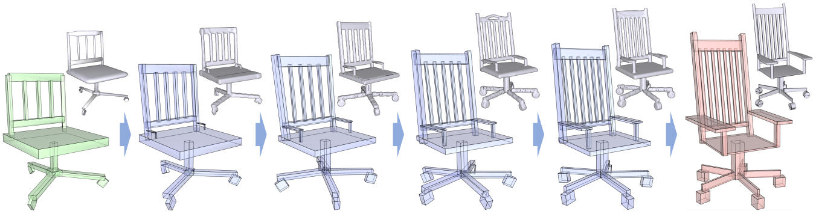
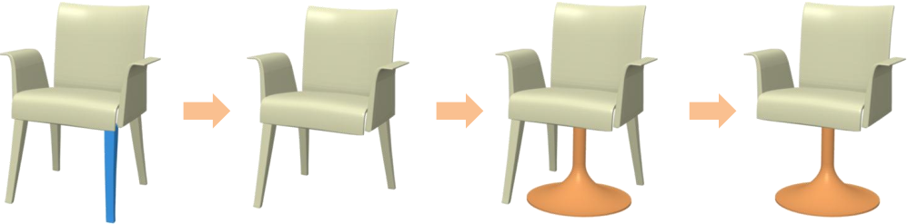
3D Cuboid Abstraction
Structure coherence
Shape functionality
[Kim et al. 2013]
[Hu et al. 2018]
Shape editing
Shape generation
[Fu et al. 2016]
[Li et al. 2017]
Notes:
We can abstract a 3D shape as an assembly of primitives, to get the underlying shape structure.
The cuboid is a relatively simple primitive (click) which can represent the part of 3D shapes.
The shape abstraction can help us, to exploit the intrinsic structure coherence, predict object functionality, edit 3d shapes, and generate novel shapes.

Slide 5
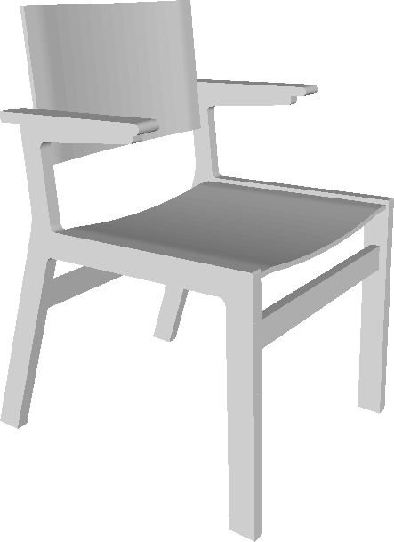
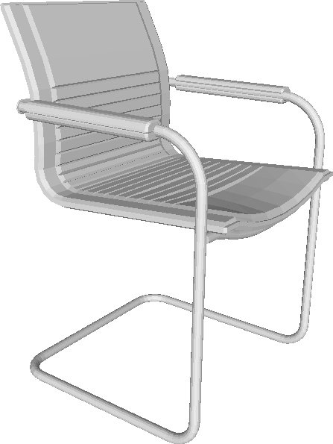
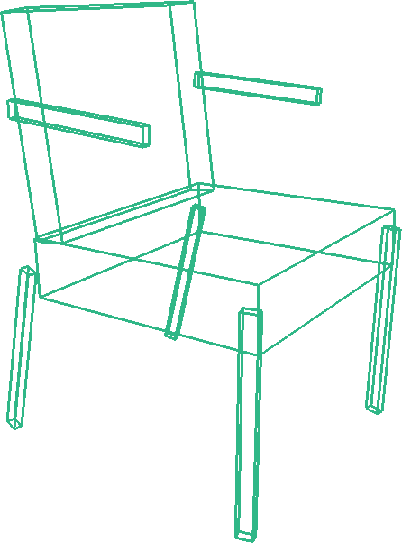
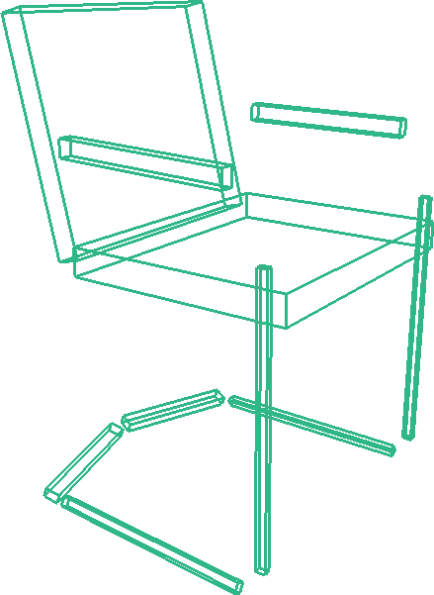
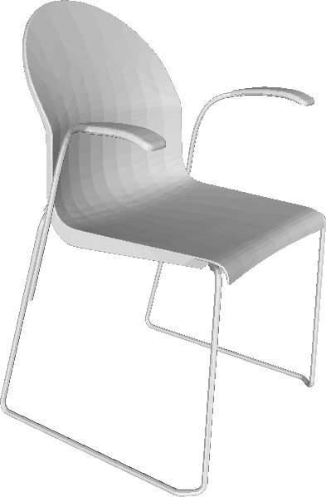
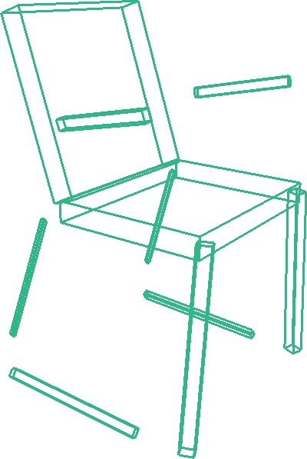
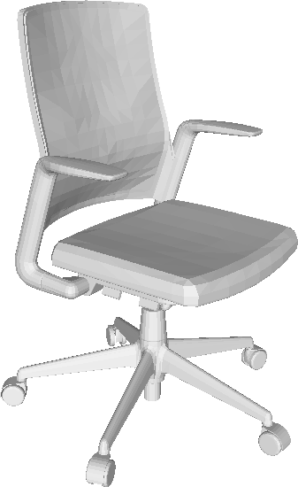
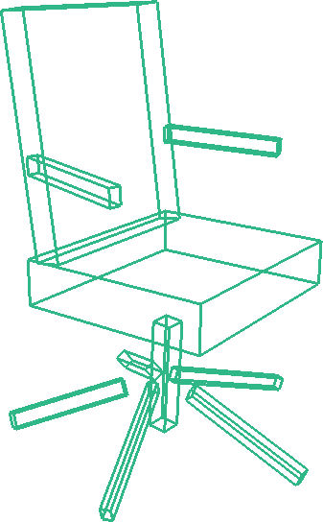
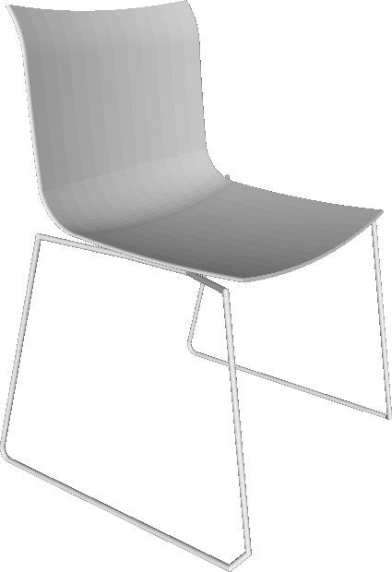
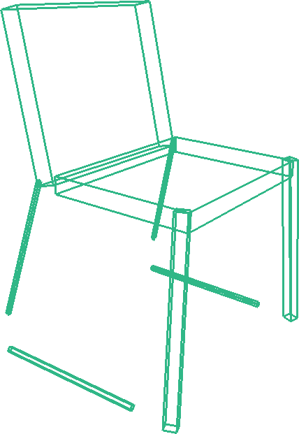
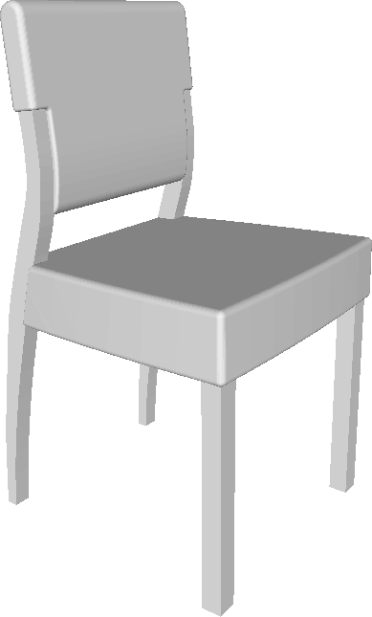
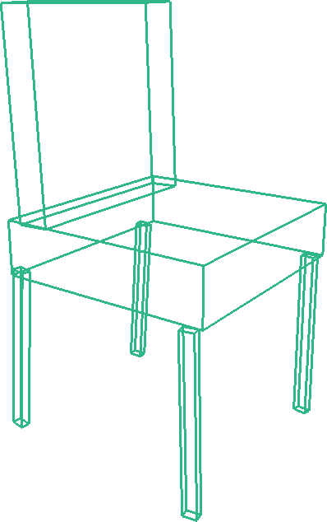
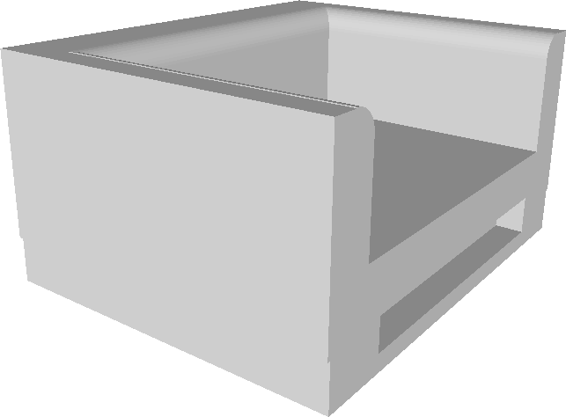
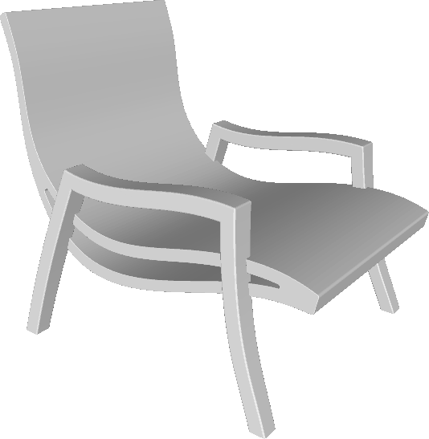
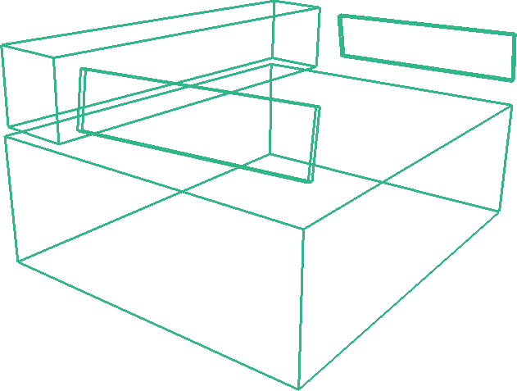
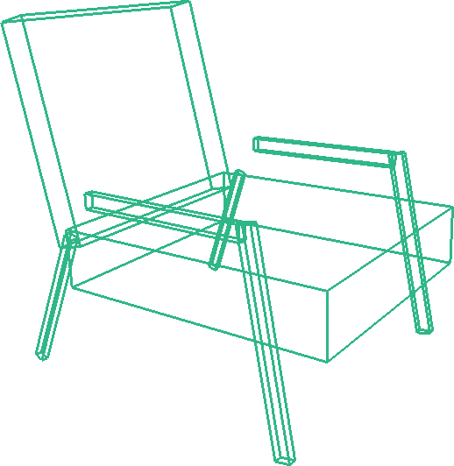
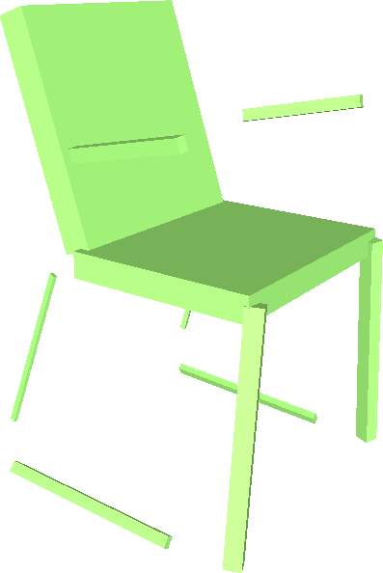
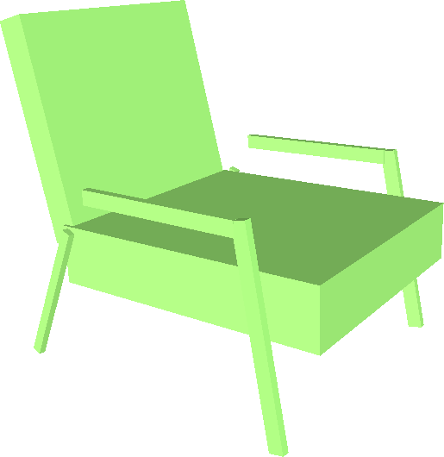
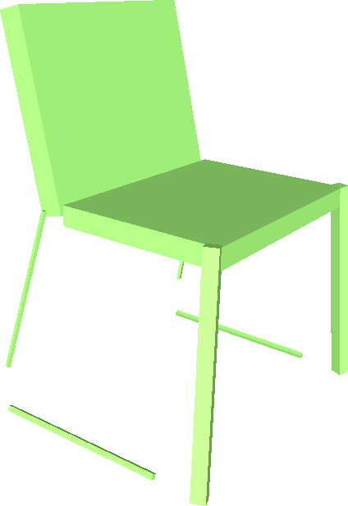
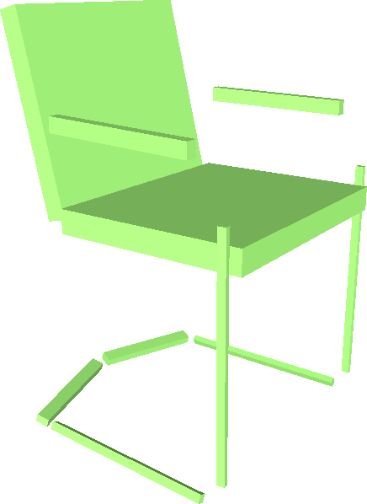
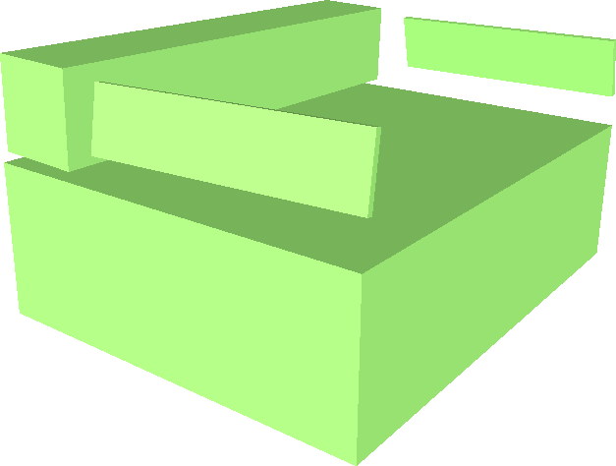
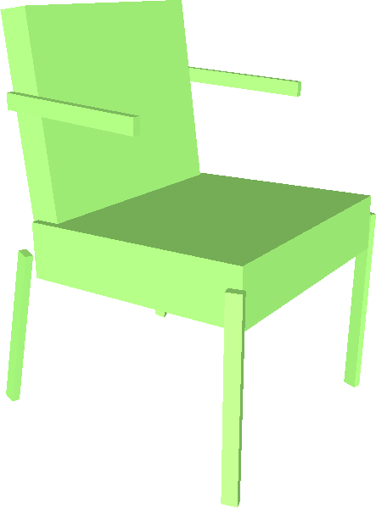
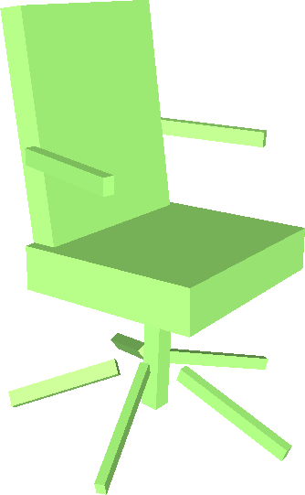
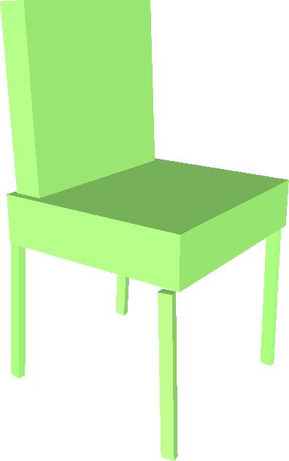
Our Goal
Construct a good 3D abstraction for shapes in a class
Notes:
The goal of our paper is to construct a good 3D abstraction for shapes in a class.

Slide 6

Our Goal
Construct a good 3D abstraction for shapes in a class
Compact
Expressive
Adaptive
Consistent
Notes:
So what is a good 3D abstraction.
(click) Firstly, it should be compact. We want to use as few as possible primitives, to abstract a 3D shape.
(click) Secondly, the abstraction should be expressive, so that it can abstract 3D shapes with different structures.
(click) Thirdly, the abstraction should be adaptive because different parts of a 3D shape may exhibit different levels of structure details.
(click) Finally, the structure of the primitives, should be consistent among different shapes, so that it can easily reveal the common structure and sub-structure shared by different objects.

Slide 7
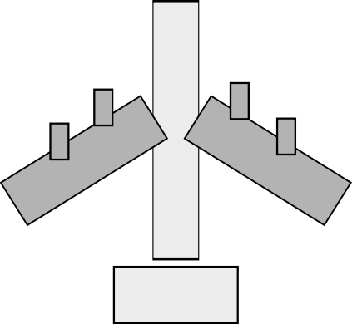
Our Goal
Construct a good 3D abstraction for shapes in a class
Compact
Expressive
Adaptive
Consistent
Notes:
So what is a good 3D abstraction?
(click) Firstly, it should be compact. We want to use as few as possible primitives to abstract a 3D shape.
(click) Secondly, the abstraction should be expressive, so that it can abstract 3D shapes with different structures.
(click) Thirdly, the abstraction should be adaptive, because different parts of a 3D shape, may exhibit different levels of structure details.
(click) Finally, the structure of the primitives, should be consistent among different shapes, so that it can easily reveal the common structure and sub-structure shared by different objects.

Slide 8
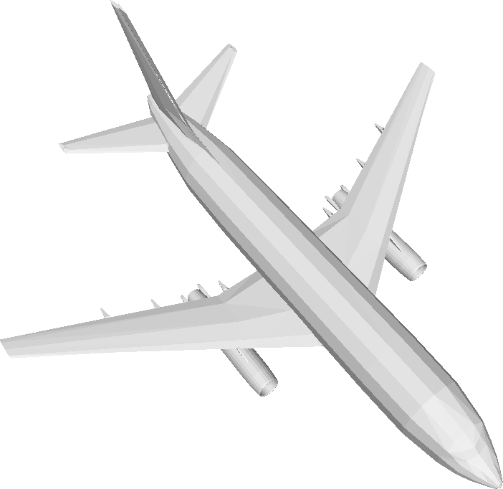
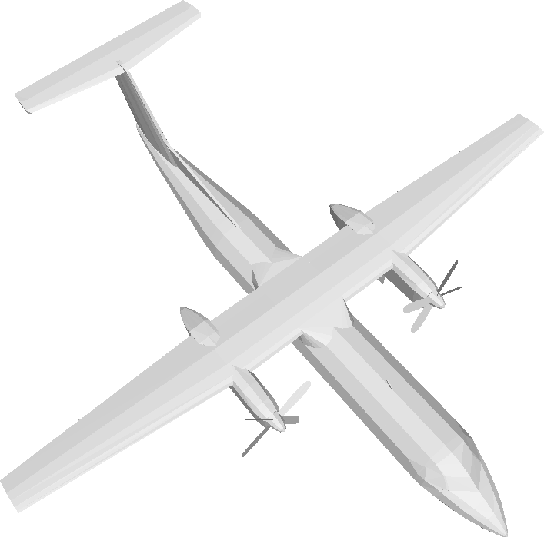
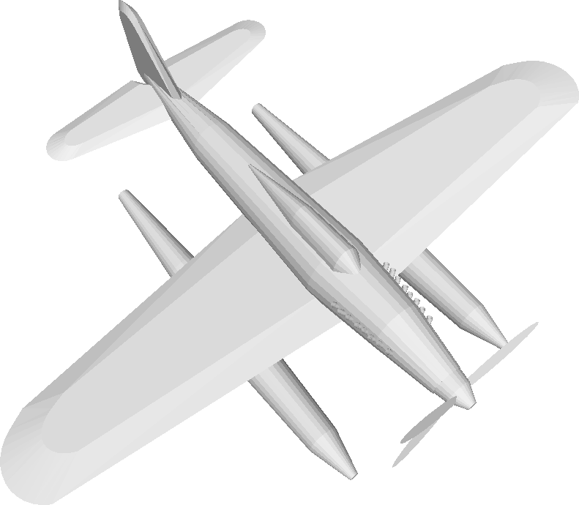
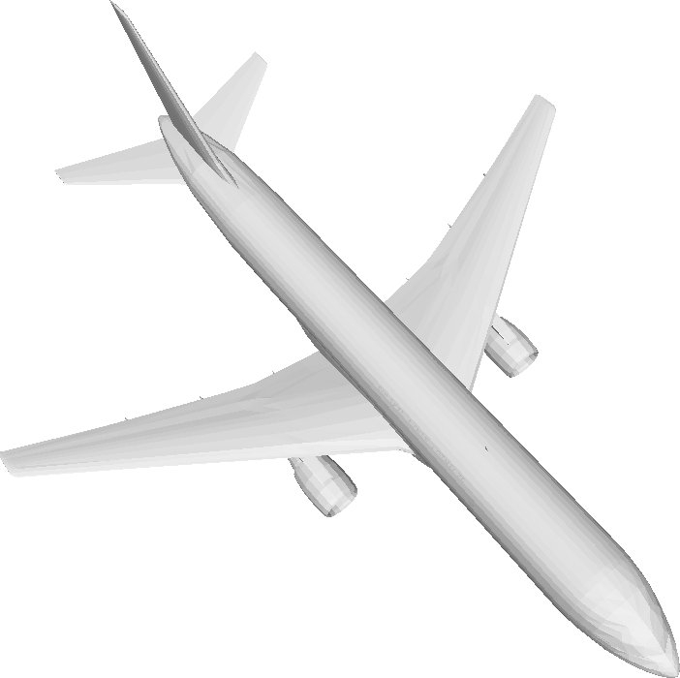
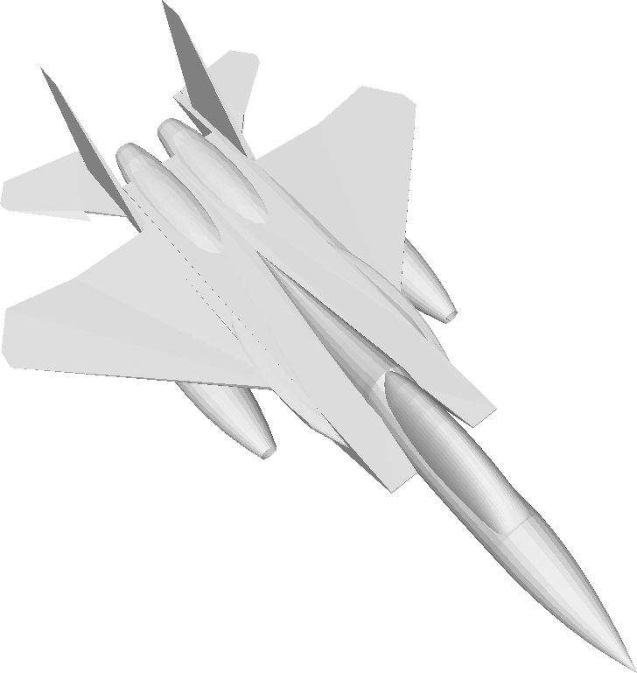
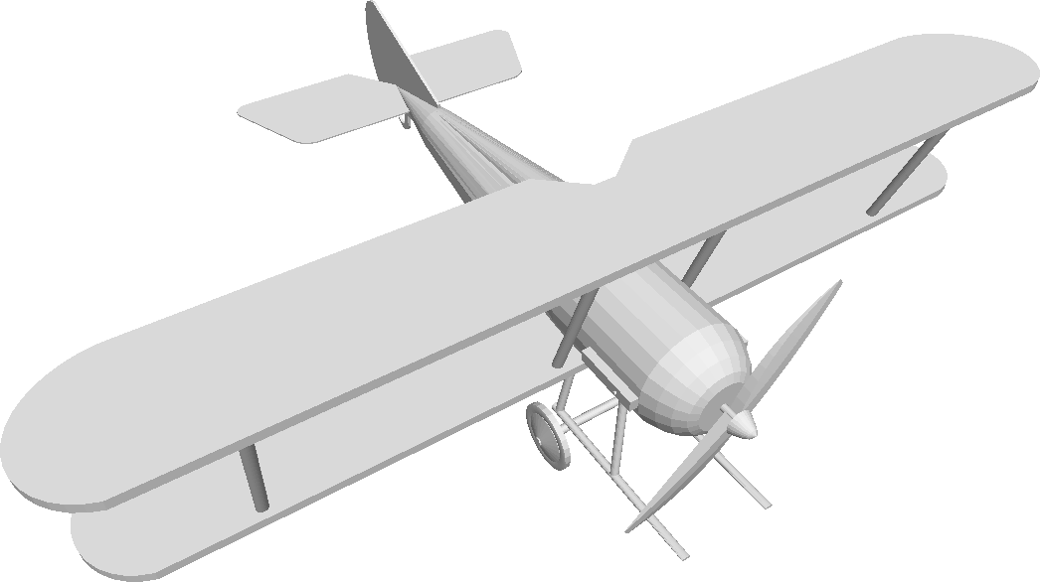
Our Goal
Construct a good 3D abstraction for shapes in a class
Compact
Expressive
Adaptive
Consistent
Notes:
So what is a good 3D abstraction?
(click) Firstly, it should be compact. We want to use as few as possible primitives to abstract a 3D shape.
(click) Secondly, the abstraction should be expressive, so that it can abstract 3D shapes with different structures.
(click) Thirdly, the abstraction should be adaptive, because different parts of a 3D shape, may exhibit different levels of structure details.
(click) Finally, the structure of the primitives, should be consistent among different shapes, so that it can easily reveal the common structure and sub-structure shared by different objects.

Slide 9
Our Goal
Construct a good 3D abstraction for shapes in a class
Compact
Expressive
Adaptive
Consistent
Notes:
So what is a good 3D abstraction?
(click) Firstly, it should be compact. We want to use as few as possible primitives to abstract a 3D shape.
(click) Secondly, the abstraction should be expressive, so that it can abstract 3D shapes with different structures.
(click) Thirdly, the abstraction should be adaptive, because different parts of a 3D shape, may exhibit different levels of structure details.
(click) Finally, the structure of the primitives, should be consistent among different shapes, so that it can easily reveal the common structure and sub-structure shared by different objects.

Slide 10
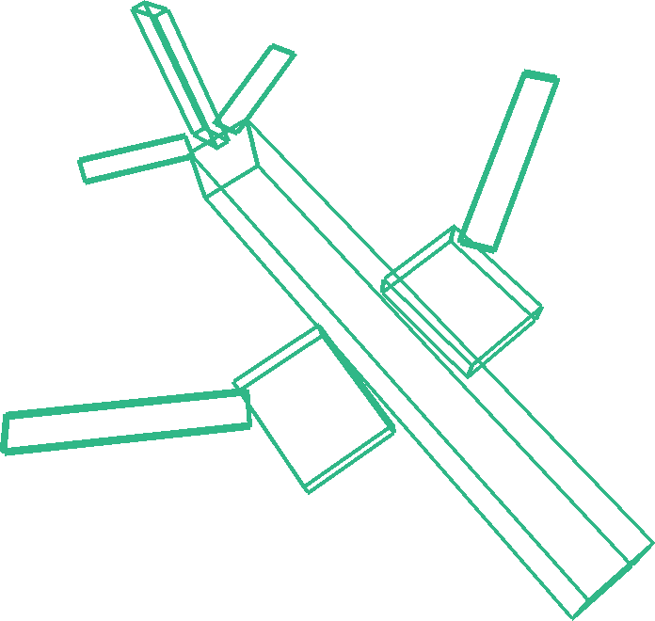
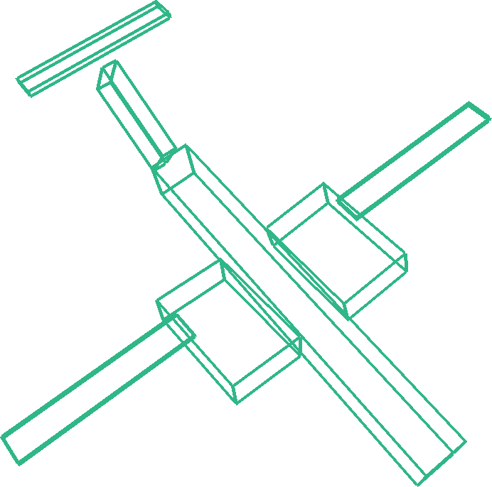


Our Goal
Construct a good 3D abstraction for shapes in a class
Compact
Expressive
Adaptive
Consistent
Notes:
So what is a good 3D abstraction?
(click) Firstly, it should be compact. We want to use as few as possible primitives to abstract a 3D shape.
(click) Secondly, the abstraction should be expressive, so that it can abstract 3D shapes with different structures.
(click) Thirdly, the abstraction should be adaptive, because different parts of a 3D shape, may exhibit different levels of structure details.
(click) Finally, the structure of the primitives, should be consistent among different shapes, so that it can easily reveal the common structure and sub-structure shared by different objects.

Slide 11



Related Works
Supervised methods
Expressiveness
Compactness
Need labeled data
Lack consistency
[Du et al. 2018]
[Zou et al. 2017]
[Li et al. 2017]
[Niu et al. 2018]
Notes:
There are two aspects of the related works.
Supervised methods use a lot of labeled data.
(click) They can get the abstraction with good expressiveness and compactness.
(click) However, labeling shape structure is tough.
And the labeled structure are not consistent and restrict the model’s generality.

Slide 12


Related Works
Unsupervised methods
Consistency
No need labelled data
Weak expressiveness
Over-simplification
[Tulsiani et al. 2017]
Notes:
Unsupervised methods (click) can abstract 3D shapes, without any structure annotations, and get a consistent cuboid representation.
(click) However, the state of the art method uses a single level abstraction.
It cannot well address structure variations, and results in over-simplified abstraction.

Slide 13
Contributions
Design a good 3D representation for shape abstraction
Propose an unsupervised method to abstract 3D shapes
Notes:
The main contributions of our paper, are that we design a good 3D representation for shape abstraction, (click) and we propose an unsupervised method to abstract 3D shapes.

Slide 14



Key Observations
Share a common structure at a higher abstraction level
Tail
Airframe
Wings
Notes:
How to design a good 3D abstraction. we have two key observations.
While 3D objects in a class have various structure, they share a common structure at a higher abstraction level.
For example, the three airplanes here have different structure details, but they are all composed of one single airframe, one tail, and two wings.

Slide 15



Key Observations
Share a common structure at a higher abstraction level
Exhibit various structure details in different abstraction levels
Notes:
Secondly, different shapes may exhibit various structure details, in different abstraction levels.
For example, the tail of the airplane has more fine-grain structure than the airframe.

Slide 16

Solution
Adaptive hierarchical cuboid representation
Adaptive hierarchical
cuboid representation
Input 3D shape
Hierarchical structure
Notes:
Based on the two observations, our solution is an adaptive hierarchical cuboid representation.
On the left (click) is the input 3D shape; (click) in the middle is the hierarchical structure of the abstraction, and (click) on the right is the adaptive hierarchical cuboid representation.
We want to capture as much as possible structure details, on multiple levels, and get a coherence abstraction at a higher level.

Slide 17









Cuboid Abstraction
(Scale, Rotation, Translation)
Notes:
Let’s go to the details of our representation.
A cuboid is parameterized as a unit cube, centered at the original point, under a rigid transformation. (click)
We use a set of cuboids to abstract a 3D shape.
The union of the cuboids, should compactly cover the input 3D shape.
And each cuboid is expected to represent a unique part of the 3D shape.

Slide 18





Hierarchical Cuboid Abstraction
Notes:
Then we introduce hierarchy to the cuboid abstraction.
For a good 3D abstraction, the number of cuboids, should vary according to the complexity of the input 3D shape.
However, too few cuboids (click) cannot capture small shape details, and too many cuboids (click) might yield an over-decomposition.
(click) For a good hierarchical abstraction, each level should be a good approximation, to the input 3D shape.
The part approximated by the children cuboids, can also be approximated by their parent cuboid.

Slide 19




Adaptive Cuboid Abstraction
Notes:
Adaptively picking cuboids from the hierarchy, we get the adaptive cuboid abstraction.
The union of cuboids we picked, is also a good approximation, with as few as possible cuboids.
Each level of the abstraction, is also a good approximation to the input 3D shape.

Slide 20

Challenges
How many cuboids to use?
The adaptive hierarchy is unknown.
The parameters of the cuboids are unknown.
Notes:
So how to generate this representation from unlabeled 3D shape data.
There are several challenges:
For a given 3D shape, (click) how many cuboids should we use.
And what hierarchy should the abstraction follows.
Finally, how to optimize the parameters of the cuboids?

Slide 21







Key Idea
Selected node
Virtual Root
Level-1
Level-2
$$C_{adapt}$$
Level-3
Input 3D shape
Hierarchical structure
Abstraction
Notes:
This is our key idea.
(click) Given the input 3D shape, we start from an (click) initial candidate cuboid hierarchy, with a fixed yet redundant number of cuboids in each level.
Each level of the cuboids is a good approximation to the input 3D shape.
(click) Considering the similarity and compactness of the representation, we select some cuboids from this hierarchy to form our adaptive cuboid abstraction, which is a good and compact approximation to the input 3D shape.

Slide 22


Unsupervised Learning Method
Cuboid prediction module
Latent code
Cuboid abstraction encoder
Cuboid selection module
Notes:
Our solution is an unsupervised learning method. It consists of three components.
(click) Given an input 3D shape, we use a shape encoder network, to get a latent code.
Then the cuboid prediction module, (click) decodes the latent code to three levels of cuboid abstraction, with a hierarchy structure.
Next, (click) the cuboid selection module, predicts three levels of selection masks, represented by binary signals.
(click) Using the selection masks, a set of cuboids are picked from the hierarchy, to form the adaptive cuboid abstraction.
(click) During training, we update the cuboid prediction and selection module iteratively, to refine the masks and the cuboid parameters.
(click) And finally, we get a good adaptive cuboid abstraction of the input 3D shape.

Slide 23

Encoder
O-CNN: Octree-based Convolutional Neural Network [Wang et al. 2017]
Latent code
Cuboid abstraction encoder
Notes:
The encoder of our method is an octree-based network.
We represent our input 3D shape as an octree, and use an octree-based encoder to get the latent code.

Slide 24







Two Branched Decoders
Fully connected network
Cuboid prediction module
Latent code
$$M_{3}$$
$$M_{2}$$
Cuboid selection module
$$M_{1}$$
Notes:
Then the latent code is decoded, by two-branched decoders. One is for predicting the cuboid parameters, and the other is for getting the selection masks.

Slide 25

Shape Similarity
Volume coverage loss
Surface coverage loss
Mutex loss
Hierarchical loss
Notes:
In order to train the cuboid prediction module, we use some loss functions to encourage the shape similarity.

Slide 26


Shape Similarity
Volume coverage loss
Surface coverage loss
Mutex loss
Hierarchical loss
Notes:
Each part of the 3D shape should locate in a cuboid, this is encouraged, by the volume coverage loss.

Slide 27
Shape Similarity
Volume coverage loss
Surface coverage loss
Mutex loss
Hierarchical loss
Notes:
The cuboid should compactly cover the inside part. The surface coverage loss, will penalize the surface difference, between the cuboid and the part.

Slide 28


Shape Similarity
Volume coverage loss
Surface coverage loss
Mutex loss
Hierarchical loss
Notes:
The mutex loss encourages, that the overlap between cuboids, should be as small as possible, so that each cuboid can represent, a unique part of the input 3D shape.

Slide 29
Shape Similarity
Volume coverage loss
Surface coverage loss
Mutex loss
Hierarchical loss
Notes:
The hierarchical loss, helps build the hierarchy relationship, between adjacent levels.
It means the part, approximated by the children cuboids, can also be approximated by their parent cuboid.

Slide 30
Mask Selection
Tree completion loss
Mask sparsity loss
Approximation loss
Hierarchical structure
Notes:
Then we use some loss functions, to guide the selection of masks.
The cuboids we picked from the hierarchy, should form a complete shape. (click)
Based on the complete shape, we want use as few as possible cuboids, to get an abstraction with high similarity.
So our selection process, should balance the compactness, and the similarity of the selected cuboids.

Slide 31
Mask Selection
Tree completion loss
Mask sparsity loss
Approximation loss
Compactness
Similarity
Completion
Notes:
Then we use some loss functions, to guide the selection of masks.
The cuboids we picked from the hierarchy, should form a complete shape. (click)
Based on the complete shape, we want use as few as possible cuboids, to get an abstraction, with high similarity.
So our selection process, should balance the compactness, and the similarity of the selected cuboids.

Slide 32
Mask Selection
Virtual Root
Tree completion loss
Mask sparsity loss
Approximation loss
Hierarchical structure
Notes:
The tree completion loss, encourages that the masks we selected, should form a complete tree.
That means (click) in each path from the leaf node to the root node, the sum of selection probability of the cuboid, should be equal to one.
So one and only one cuboid should be picked from each path.

Slide 33

Mask Selection
Virtual Root
Tree completion loss
Mask sparsity loss
Approximation loss
$$\sum_{i∈path}{p_{i}}=1$$
Selection probability of the cuboid in the path
Hierarchical structure
Notes:
The tree completion loss, encourages that the masks we selected, should form a complete tree.
That means (click) in each path from the leaf node to the root node, the sum of selection probability of the cuboid, should be equal to one.
So one and only one cuboid should be picked from each path.

Slide 34


Mask Selection
Incomplete
Virtual Root
Tree completion loss
Mask sparsity loss
Approximation loss
Hierarchical structure
Notes:
However, the network cannot always guarantee, the sum of probability in each path, equal to one.
After rounding the probability values to zero or one (click), the selection tree may be incomplete, or be redundant.
We use a simple way to fix this issue. Please refer to our paper for the details.
(click) And mostly we get a complete tree.

Slide 35


Mask Selection
Redundant
Tree completion loss
Mask sparsity loss
Approximation loss
Hierarchical structure
Notes:
However, the network cannot always guarantee, the sum of probability in each path, equal to one.
After rounding the probability values to zero or one (click), the selection tree may be incomplete, or be redundant.
We use a simple way to fix this issue. Please refer to our paper for the details.
(click) And mostly we get a complete tree.

Slide 36

Mask Selection
Complete
Tree completion loss
Mask sparsity loss
Approximation loss
Hierarchical structure
Notes:
However, the network cannot always guarantee, the sum of probability in each path, equal to one.
After rounding the probability values to zero or one (click), the selection tree may be incomplete, or be redundant.
We use a simple way to fix this issue. Please refer to our paper for the details.
(click) And mostly we get a complete tree.

Slide 37



Mask Selection
Tree completion loss
Mask sparsity loss
Approximation loss
$$C_{adapt}$$
$$\#$$
Hierarchical structure
Notes:
The mask sparsity loss encourages, that the number of cuboids we picked, should be as small as possible.

Slide 38

Mask Selection
Tree completion loss
Mask sparsity loss
Approximation loss
$$C_{adapt}$$
Refer to our paper for more details.
Notes:
And the approximation loss encourages, the selected cuboids should also be a good approximation to the input 3D shape.
For the formulation details of each loss function, please refer to our paper.

Slide 39

Training Scheme
Cuboid prediction module
Initial training
Cuboid abstraction encoder
Cuboid selection module
Notes:
We train our network using a progressive training scheme.
(click) Firstly, we train the network to generate the cuboid abstraction with hierarchy.
(click) Then, by fixing the encoder and the prediction module, we train the cuboid selection module, to get the selection masks.
(click) Now we get the initial adaptive cuboid abstraction.

Slide 40




Training Scheme
Cuboid prediction module
Cuboid selection training
Initial training
$$M_{3}$$
Cuboid abstraction encoder
$$M_{2}$$
$$M_{1}$$
Cuboid selection module
Notes:
We train our network using a progressive training scheme.
(click) Firstly, we train the network to generate the cuboid abstraction with hierarchy.
(click) Then, by fixing the encoder and the prediction module, we train the cuboid selection module, to get the selection masks.

Slide 41




Training Scheme
Cuboid prediction module
Cuboid selection training
Iterative training
$$M_{3}$$
Cuboid abstraction encoder
$$M_{2}$$
$$M_{1}$$
Cuboid selection module
Notes:
Now we get the initial adaptive cuboid abstraction.
Next, (click) we pay more attention, to the selected cuboids.
We train the cuboid prediction and selection module iteratively, to refine the masks and the cuboid parameters.
(click) Finally, we finetune the whole network, using a smaller learning rate.

Slide 42
Training Scheme
Cuboid prediction module
Iterative training
Cuboid abstraction encoder
Cuboid selection module
Notes:
Now we get the initial adaptive cuboid abstraction.
Next, (click) we pay more attention, to the selected cuboids.
We train the cuboid prediction and selection module iteratively, to refine the masks and the cuboid parameters.
(click) Finally, we finetune the whole network, using a smaller learning rate.

Slide 43
Experiment Settings
Airplane, chair, table from ShapeNet, animal from [Tulsiani et al. 2017]
Train one network for each category
Use the same loss function weights for the four categories
Implementation:
Tensorflow
Batch size 32
1000 epochs for initial training, 200 epochs for each iterative training step
Notes:
The network is trained separately, on four man-made shape categories.
And we use the same loss function weights for each category.

Slide 44




Results
Airplane body
Chair seat
The cuboids with the same color are the correspondence parts in each category.
Notes:
Here are the abstraction results predicted by our network.
In each category, the cuboids with the same color (click) are the correspondence parts in different shapes.
The body of the airplane is represented by the blue cuboid.
And the seat of the chair is represented by the red cuboid.

Slide 45




Structure-based Classification
Notes:
Focus on the chair class. We cluster them by their abstraction structure.
In the same group, all the chairs have the same structure. While different groups have different structures.
Also, the blue cuboid represents the chair back, and the red cuboid stands for the chair seat.

Slide 46


Cuboid Number Setting
Default cuboid number
Default configuration vs (5, 10, 20)
Category | ($\#C_{1}, \#C_{2}, \#C_{3}$)
airplane | (4, 8, 16)
chair | (8, 16, 32)
table | (3, 6, 12)
animal | (5, 10, 20)
(a) Input shape (b) (5, 10, 20) (c) default configuration
Notes:
In our default setting, each category uses a different cuboid number according to their shape complexity.
We also conduct an experiment, to use the same cuboid number for each category.
Here we show the comparison results. We can find the results using the same cuboid number, are also consistent and mostly visual pleasing.
That means our network is not sensitive to the cuboid number setting. We use the default setting to get more visual pleasing results.

Slide 47




Ablation Study
Chamfer distance
9.32 (18.68)
10.18 (18.73)
11.11 (19.03)
Full loss
w/o hierarchy loss
w/o mutex loss
training (test)
Notes:
We conduct an ablation study of some loss functions.
With all the loss functions, the network yields the adaptive abstractions with the smallest error than other settings.
Without the hierarchy loss, the hierarchical relationships between adjacent levels are not constructed, so the result structure is not pleasing.
Without the mutex loss, the overlap between cuboids are obvious, and the adaptive abstraction contains more cuboids.
We use chamfer distance to evaluate the abstraction quality. And the full loss setting gets the best results.

Slide 48


Comparison
Chamfer distance
Category | Ours | [Tulsiani et al. 2017]
Airplane | 9.32 (18.68) | 18.50 (21.22)
Chair | 18.92 (24.79) | 25.32 (27.34)
training (test)
Input
Ours
[Tulsiani et al. 2017]
Notes:
We compared our results with the work of Tulsiani, which is also an unsupervised learning method for cuboid abstraction.
They (click) use a single level cuboid setting. Without any hierarchy, their method cannot well address structure variations, and results in over-simplified abstraction.

Slide 49










Application – Shape Interpolation
Interpolate the shape in structure and geometry aware latent space.
Notes:
The latent space trained by our abstraction network, encodes useful structural and geometric information.
Given two shapes, (click) firstly we extract their abstraction structure.
(click) We interpolate the latent code and get the interpolated structures.
Then we use the structure (click) to retrieve a similar shape in the dataset, and deform the shape by the abstraction to get the final shape.

Slide 50



Application – 3D Shape Retrieval
Use the latent code of the abstraction network to retrieve similar shapes in the dataset.
Structure-aware latent code
Auto-encoder latent code
Reference shape
Notes:
We also use the latent code to retrieve similar shapes in the dataset.
(click) Here are the top-3 retrieval results using our latent code, and (click) here are the results using the auto-encoder latent code.
(click) The structure of this shape, is not similar to the reference shape structure, and our retrieval shapes have high structural similarity.

Slide 51
Conclusion
Present an adaptive hierarchical cuboid representation for 3D shape abstraction.
Introduce an unsupervised learning approach to extract the representation from unlabeled 3D shape data.
Demonstrate the superiority of our method over the existing work and apply the learned abstraction to different shape analysis tasks.
Notes:
In summary,
(click) we propose an adaptive hierarchical cuboid representation, for 3D shape abstraction.
(click) We introduce an unsupervised learning method, to extract the representation from unlabeled 3D shapes.
(click) We demonstrate the superiority of our method, over the existing work, and apply the learned abstraction, to different shape analysis tasks.

Slide 52

Limitation and Future Work
Missing small components
The volume and surface coverage losses are not high on these small components
Use available part information to guide
No explicit consistency loss
design consistency loss function to obtain more consistent results
Notes:
The limitation of our method is that, it’s hard to capture the small components, because the volume and surface coverage losses, are not high on these small parts.
The available part information, may help to guide the abstraction. (click)
Moreover, in our method, the abstraction consistency is not formulated explicitly. It is only contained in the network architecture.
How to quantize it, and use it as a loss function is worth exploring.

Slide 53
Acknowledgment
Authors of ShapeNet and [Tulsiani et al. 2017] for sharing data
Anonymous reviewers for valuable suggestions and feedbacks
Notes:
We thank the authors of ShapeNet and Tulsiani for sharing data, and the anonymous reviewers for their valuable suggestions and feedbacks.

Slide 54


Thank you
Code and Data
Notes:
Thank you for your attention. For code and data, please scan this QR code. Thanks.

Slide 55

Iterative Training Results
The tail and body of the airplane are better characterized by cuboids.
The selection mask on the tail is gradually updated.

Slide 56



Adaptive abstraction correction
Tree correction strategy
Fix incompletion
Remove redundancy
Category | r | $$N_{cor}$$
Airplane | 1.08% | 1.16
Chair | 7.83% | 1.64
Table | 1.95% | 1.23
Animal | 3.09% | 1.00
r : the number of shapes with correction over the total number of shapes
$N_{cor}$ : the average number of corrected nodes in the corrected trees
Notes:
Most results do net need any correction.
The correction ratio of the chair category is little higher due to the large structure variations, however, the number of corrected nodes is still small.

